Slide 1
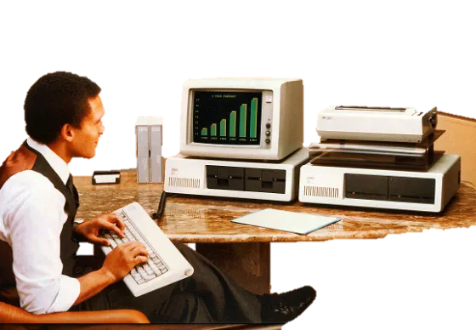

TRENDING
SYSTEMS
PROGRAMMING NOTES
240 Interest-Packed
Pages for the Hobby programmer, Home webadmin, DIY enthusiasts and
Etsy artist
FOR EVERYONE WHO USES COMPUTERS
ƒ1⁰⁰
Notes:
Pa$$word: “trendingsystems”

Slide 2
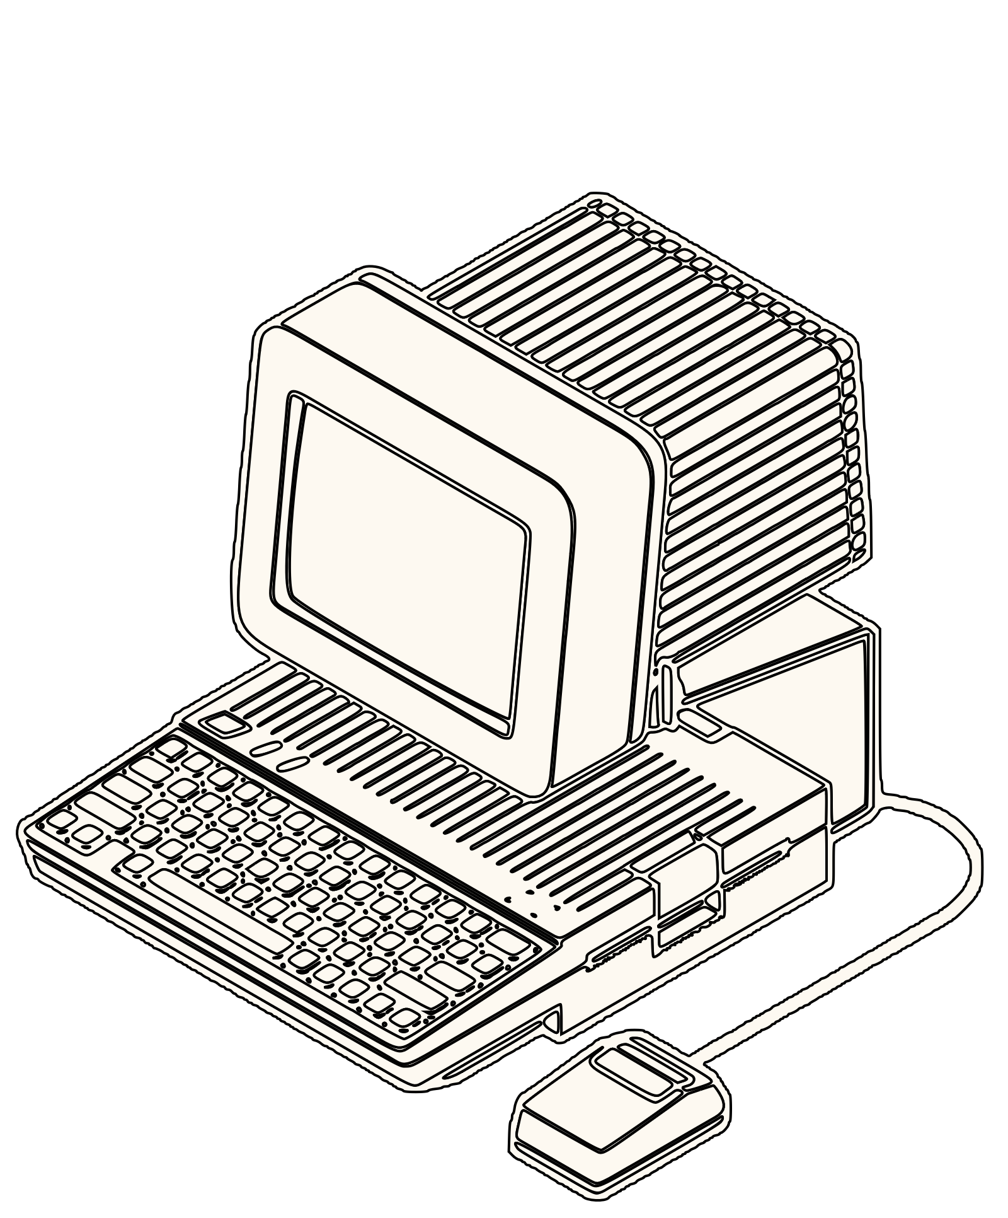
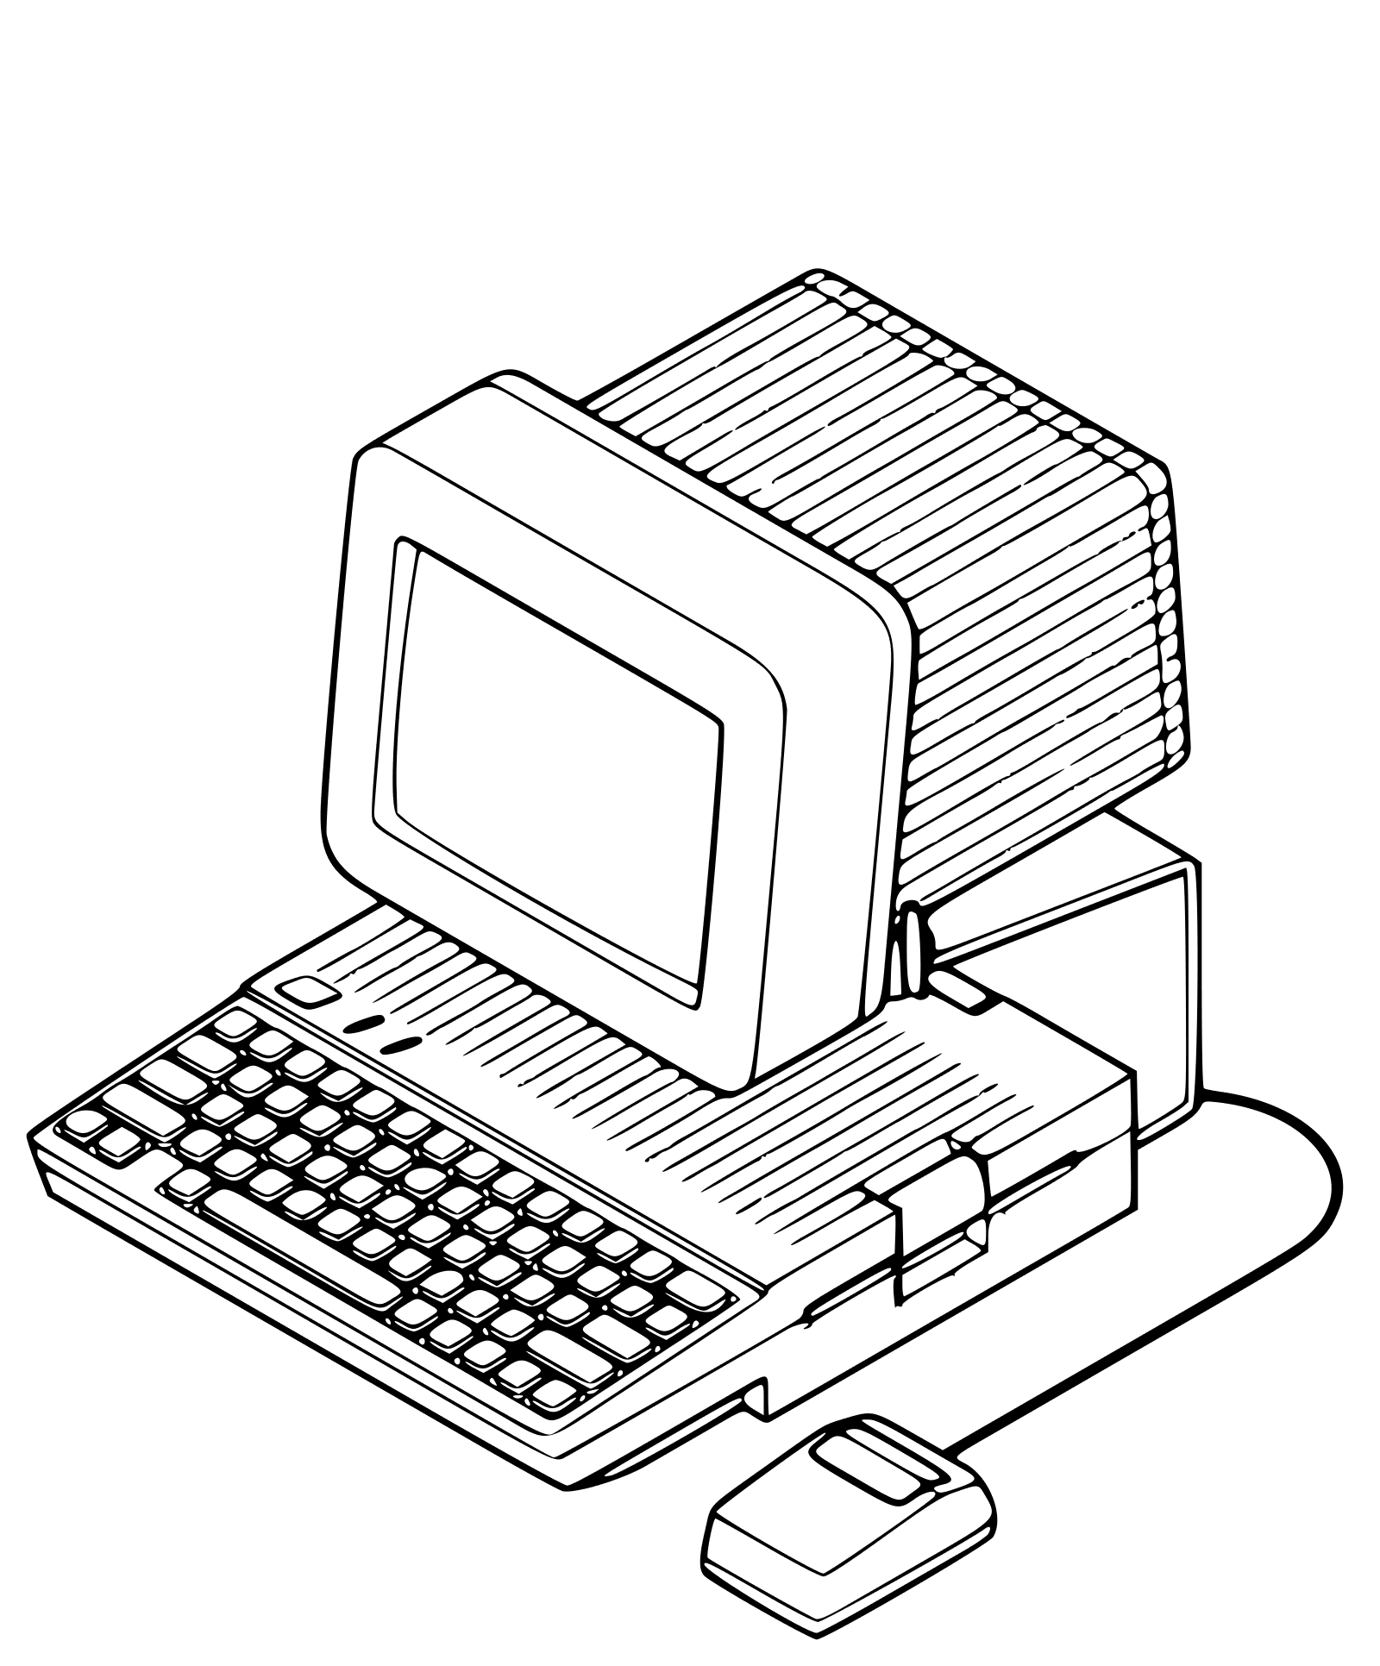
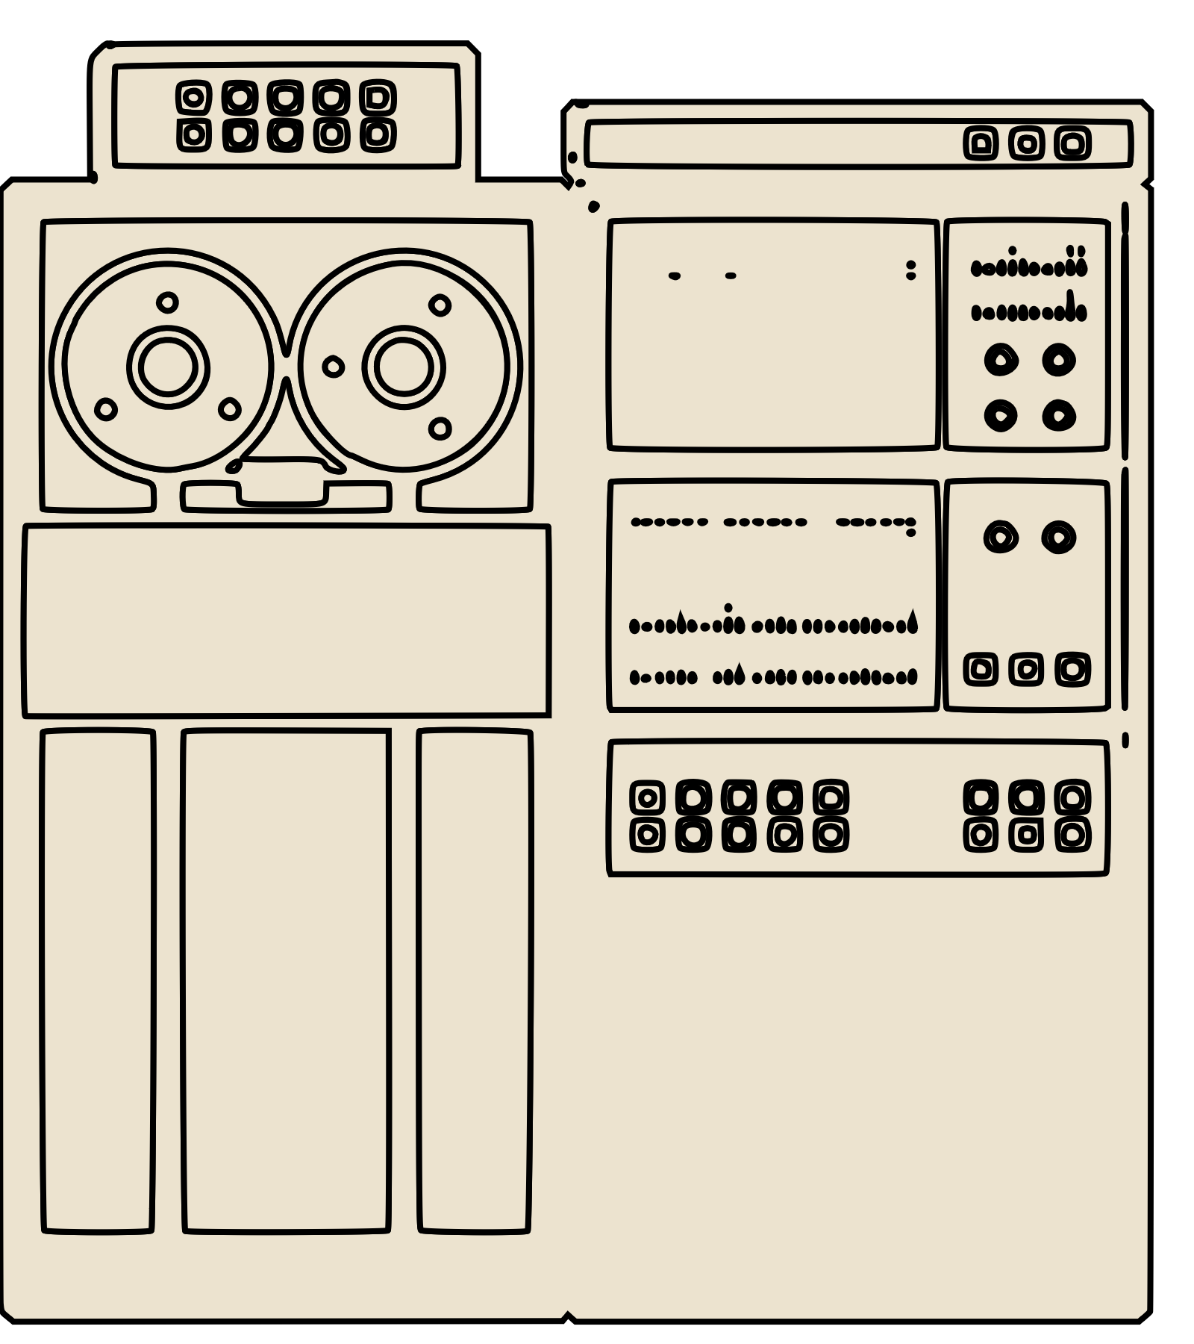
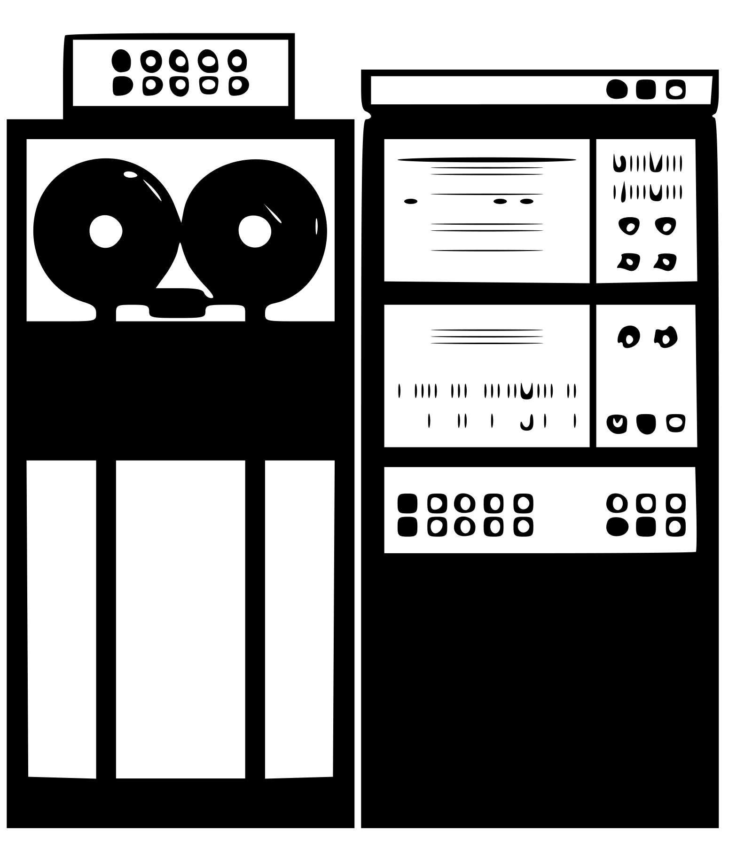
Build Your Own
internet file storage app
Part I: client
Think you’re the best? participate in our competition, check the final page
By TA Lucas
B
Y harnessing the full power of ‘the net’ you can create something close in function to commercial internet based file storages. Internet file storage is possible using socket programming, by establishing a socketed connection from client to server it is possible to send not only messages but also data of all kinds. Data is first translated into bits and bytes which the internet can understand, after which it is sent along with any additional information.
This build plan will discuss the implementation of such a storage application. The plan is laid out in two parts, the client and the server, each differ in function.
The client supports a different range of features such as, viewing the contents of the files stored on the server, sending and receiving files, chatting with other users and a login system for security.
Upon opening the client app the user is greeted with a login prompt which asks for a username and password, this gets send to and validated by the server. Upon giving valid credentials the user is shown a menu with options to the features described above.
1
2
3
4
sample1.txt
sample2.jpg
sample3.wav
…
sampleN.exe
1 View files
2 Download
3 Upload
4 Chat
5 Logout
TCP
User/
pass
True/
False
5
File to download: [user input]
7
Starting chat…
<change protocol to UDP>
[User1]: Sample text
[User2]: Response
[User1]: Who’s Joe?
[User3]: I cant see my file
Type reply:
6
File to upload: [user input]
Creden-tials.txt

Slide 3
Specifications
Nr. | Function | Description
1 | Establish connection to the server. | Upon opening the app, try to connect to the server using a TCP socket.
2 | Allow user to log in using a username and password. | Ask user for credentials, send these to the server and wait for a response. Print connection status.
3 | Display the menu to the user. | The menu has 5 options as seen above. Implement input validation and looping to make the menu robust.
4 | View the list of files either on local storage or on the server. | Ask user if they want to see the local files (files stored on your machine) or the files stored on the server. Then display those files by printing their filenames.
5 | Download a file from the server. | Ask user to type a filename for a file which is stored on the server. Then initiate a download. After downloading, the file should be in the local folder.
6 | Upload a file to the server. | Ask user to type a filename for a file which is stored locally. Then initiate an upload. After uploading, the file should be in the server folder.
7 | Chatting. | Initiate the chatting service by opening a UDP socket*, download the chatlog from the server and print this in the style “[username]: message” , then prompt the user to type a reply, send this reply to the server, then update the chatlog. Typing “!q” should return the user back to the menu. *note that the port number should differ from that of the TCP socket.
8 | Logout | Exit the application or return the user to the login prompt.

Slide 4


internet file storage app
Part II: server
The server acts as the backbone to all the features the client requires. A server should continually listen for incoming connections from clients. When a connection is established the server should authenticate the user. The server is also responsible for managing the files and chat server.
Upon starting the server it should bind to a standard TCP socket and wait for incoming connections. Make different handlers to serve clients with necessary data. Create a function that returns the file contents stored on the server and a function that can handle uploads and downloads.
Chatting requires opening a new UDP socket and sending the client the chatlog. Upon receiving a new message, append it to the chatlog.
1
1
2
3
TCP
TCP
UDP
chatlog.txt
Specifications
Nr. | Function | Description
1 | Connectivity | Handle client connection requests and login requests.
2 | File sharing | Server should be able to send its file contents to the clients as a list. Sever should be able to handle both uploads and downloads from the clients.
3 | Chatting | Chatting happens over a new UDP socket connection. Chats are logged in the chatlog.

Slide 5

internet file storage app
Part III: competition
Trending systems magazine has put the challenge to you, yes you, the reader and builder of this fantastic program to prove their mastery of socket programming.
To participate in this competition you need to implement something called “batch downloading”. This is an extra feature the client has in their menu, so this would be the 5th option. Batch downloading starts by initiating a timer, then it requests the server to download all available files. Once all files have been downloaded you can stop the timer. Then print the total downloading time to the console. Good luck and may the best developer(s) win.
1 View files
2 Download
3 Upload
4 Chat
5 Batch download
6 Logout
1
Specifications
Nr. | Function | Description
1 | Batch downloading | Client starts a timer, requests server to download all files available. Timer stops once the last file has been fully downloaded.
Trending systems competition form |  | Trending systems magazine Jaffalaan 5, 2628 BX Delft
Name
Address
Batch download total transfer time in seconds:
Put form in a stamped envelope together with the ƒ0.50 entry fee and a picture to prove your competition time

Slide 6
Interconnected world group project.
About.
This group programming exercise is meant as the final test of your socket programming abilities. You are tasked with creating an “internet file storage app” as described in the magazine “Trending systems”. The max group size for this project is 6.
Getting started.
Once you’ve made a group, download the project zip file from Brightspace. The zip contains two folders, client and server, work within these folders for your project. These folders also act as the file spaces for both the client and server, so a file saved to the client is stored in the folder “client”, alongside the client code.
Planning.
A recommended workflow for the project is to implement the features as follows.
Start by implementing file sending from the server to the client (downloading), this can be done in a bare bones way where the client receives a file immediately upon connecting to the server.
Expand by letting the server send a list files first, then (clientside) ask the user which file they want.
Now implement uploading, this should be similar to the implementation for downloading.
Wrap these features into a (looping) menu for the client.
Implement the batch downloading feature.
Work on the login system.
Implement chatting.
This is, of course, just a recommendation, you are free to develop this project as you see fit.
Some notes on project scope.
The files available on the sever are visible to all users, view it as a file cabinet which can be accessed by all employees in an office.
User/password authentication can be done with simple string comparisons, no security features need to be implemented.
All data is transferred on localhost.
Sending and receiving a file in this context means that a file gets transferred (via a socket) from the “server” folder to the “client” folder (and vice versa).
The chatting feature should be implemented in its most basic form. The server doesn’t need to facilitate “live” chatting. Meaning that its not required for multiple clients to be connected to chat at the same time
Also note there is only one chatroom.
Make it your own! Give your app/team a cool name.
Deadlines, deliverables and presentations.
The project will conclude with a small presentation. In this presentation you are expected to give a small demo of your app, to conclude the demo you have to run the “batch download” feature. The time it takes for the batch download to complete will be used for a competition, the fastest team can expect a small (non-grade-related reward). Use the full potential of the lecture material and you’ll be know how to knock out the competition.
Presentations happen on the 7th and 9th of June. You can indicate a preference with your group during the practical on the 2th else you’ll be assigned a date by the TA’s.
The project code is due on: 4th of June.
To hand in the project, create a zip file containing the “server” and “client” folder with your source code included. Naming convention: “IW_Project_Group[groupNr].zip”
Questions?
Hop in on the feedback sessions hosted every Friday.

